Slide 1
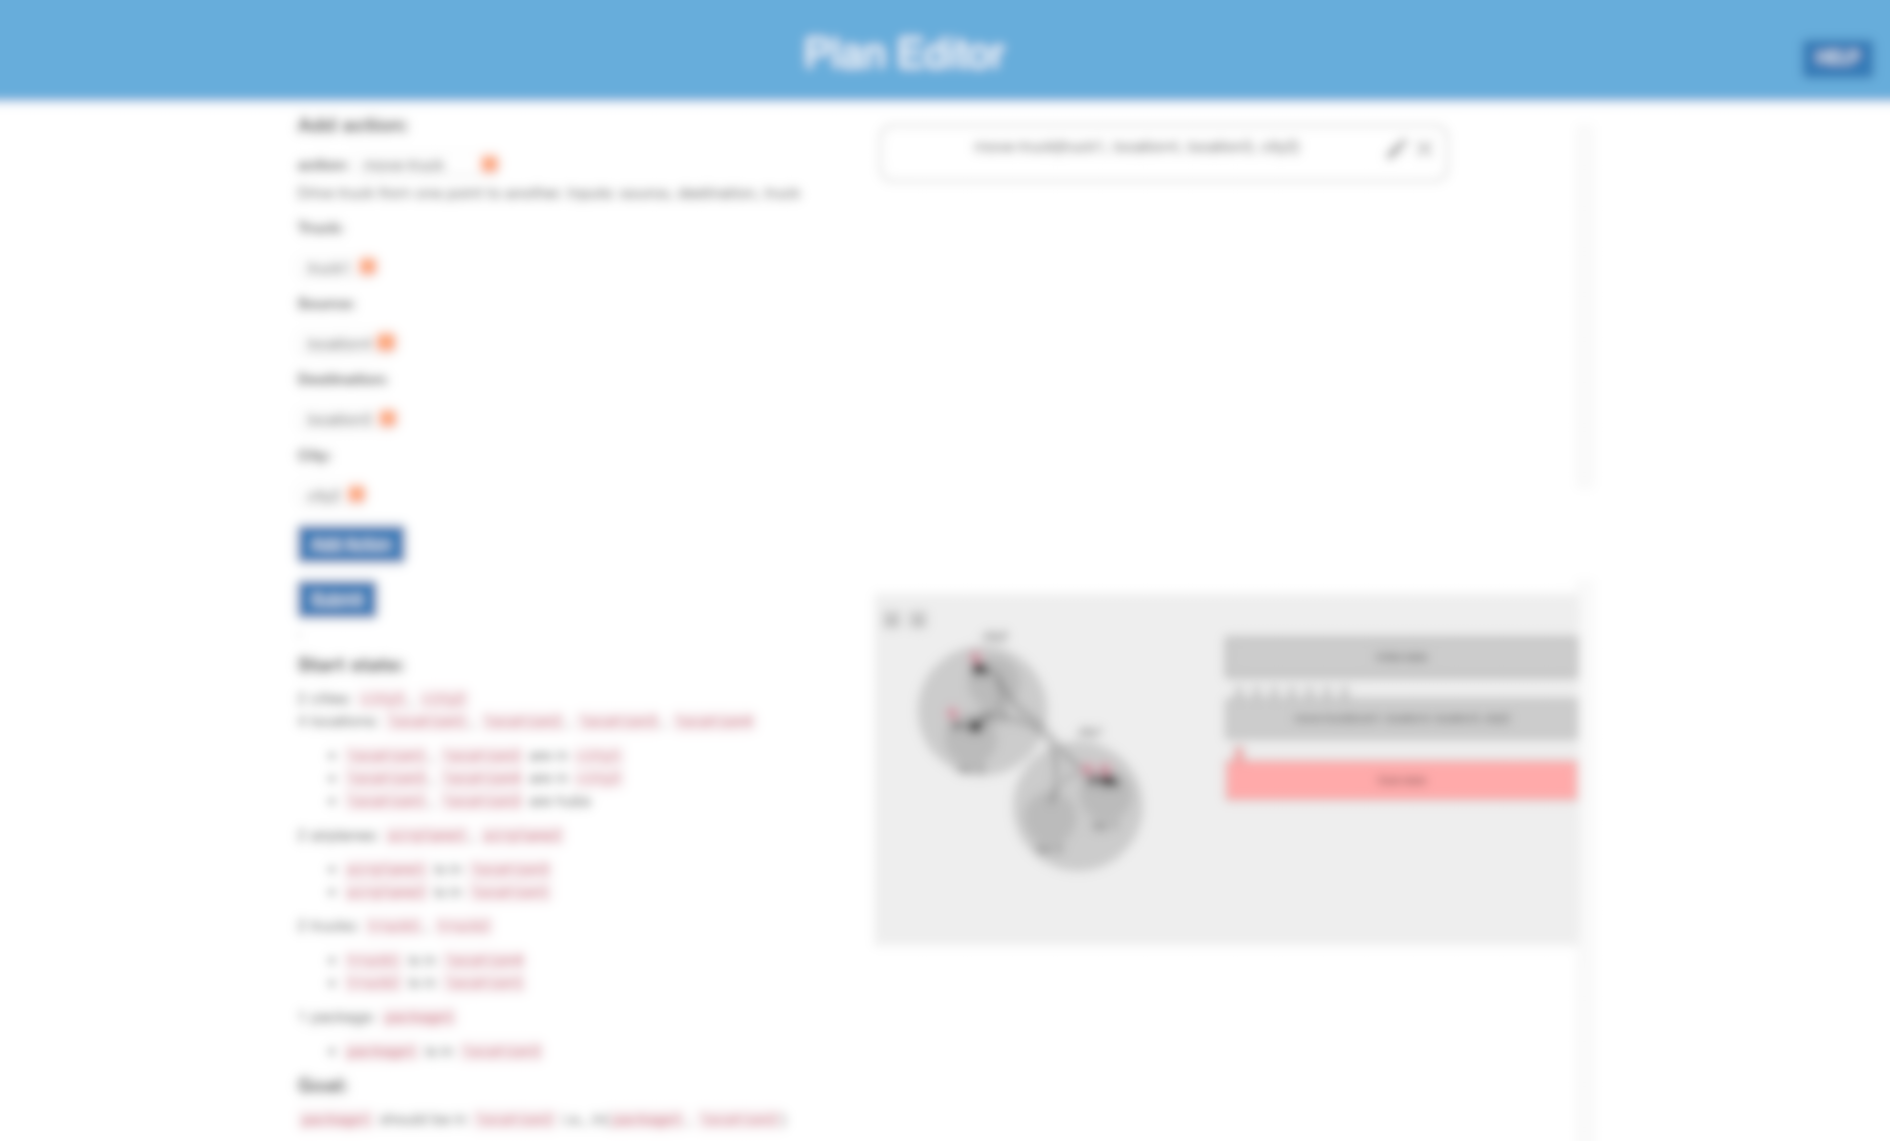
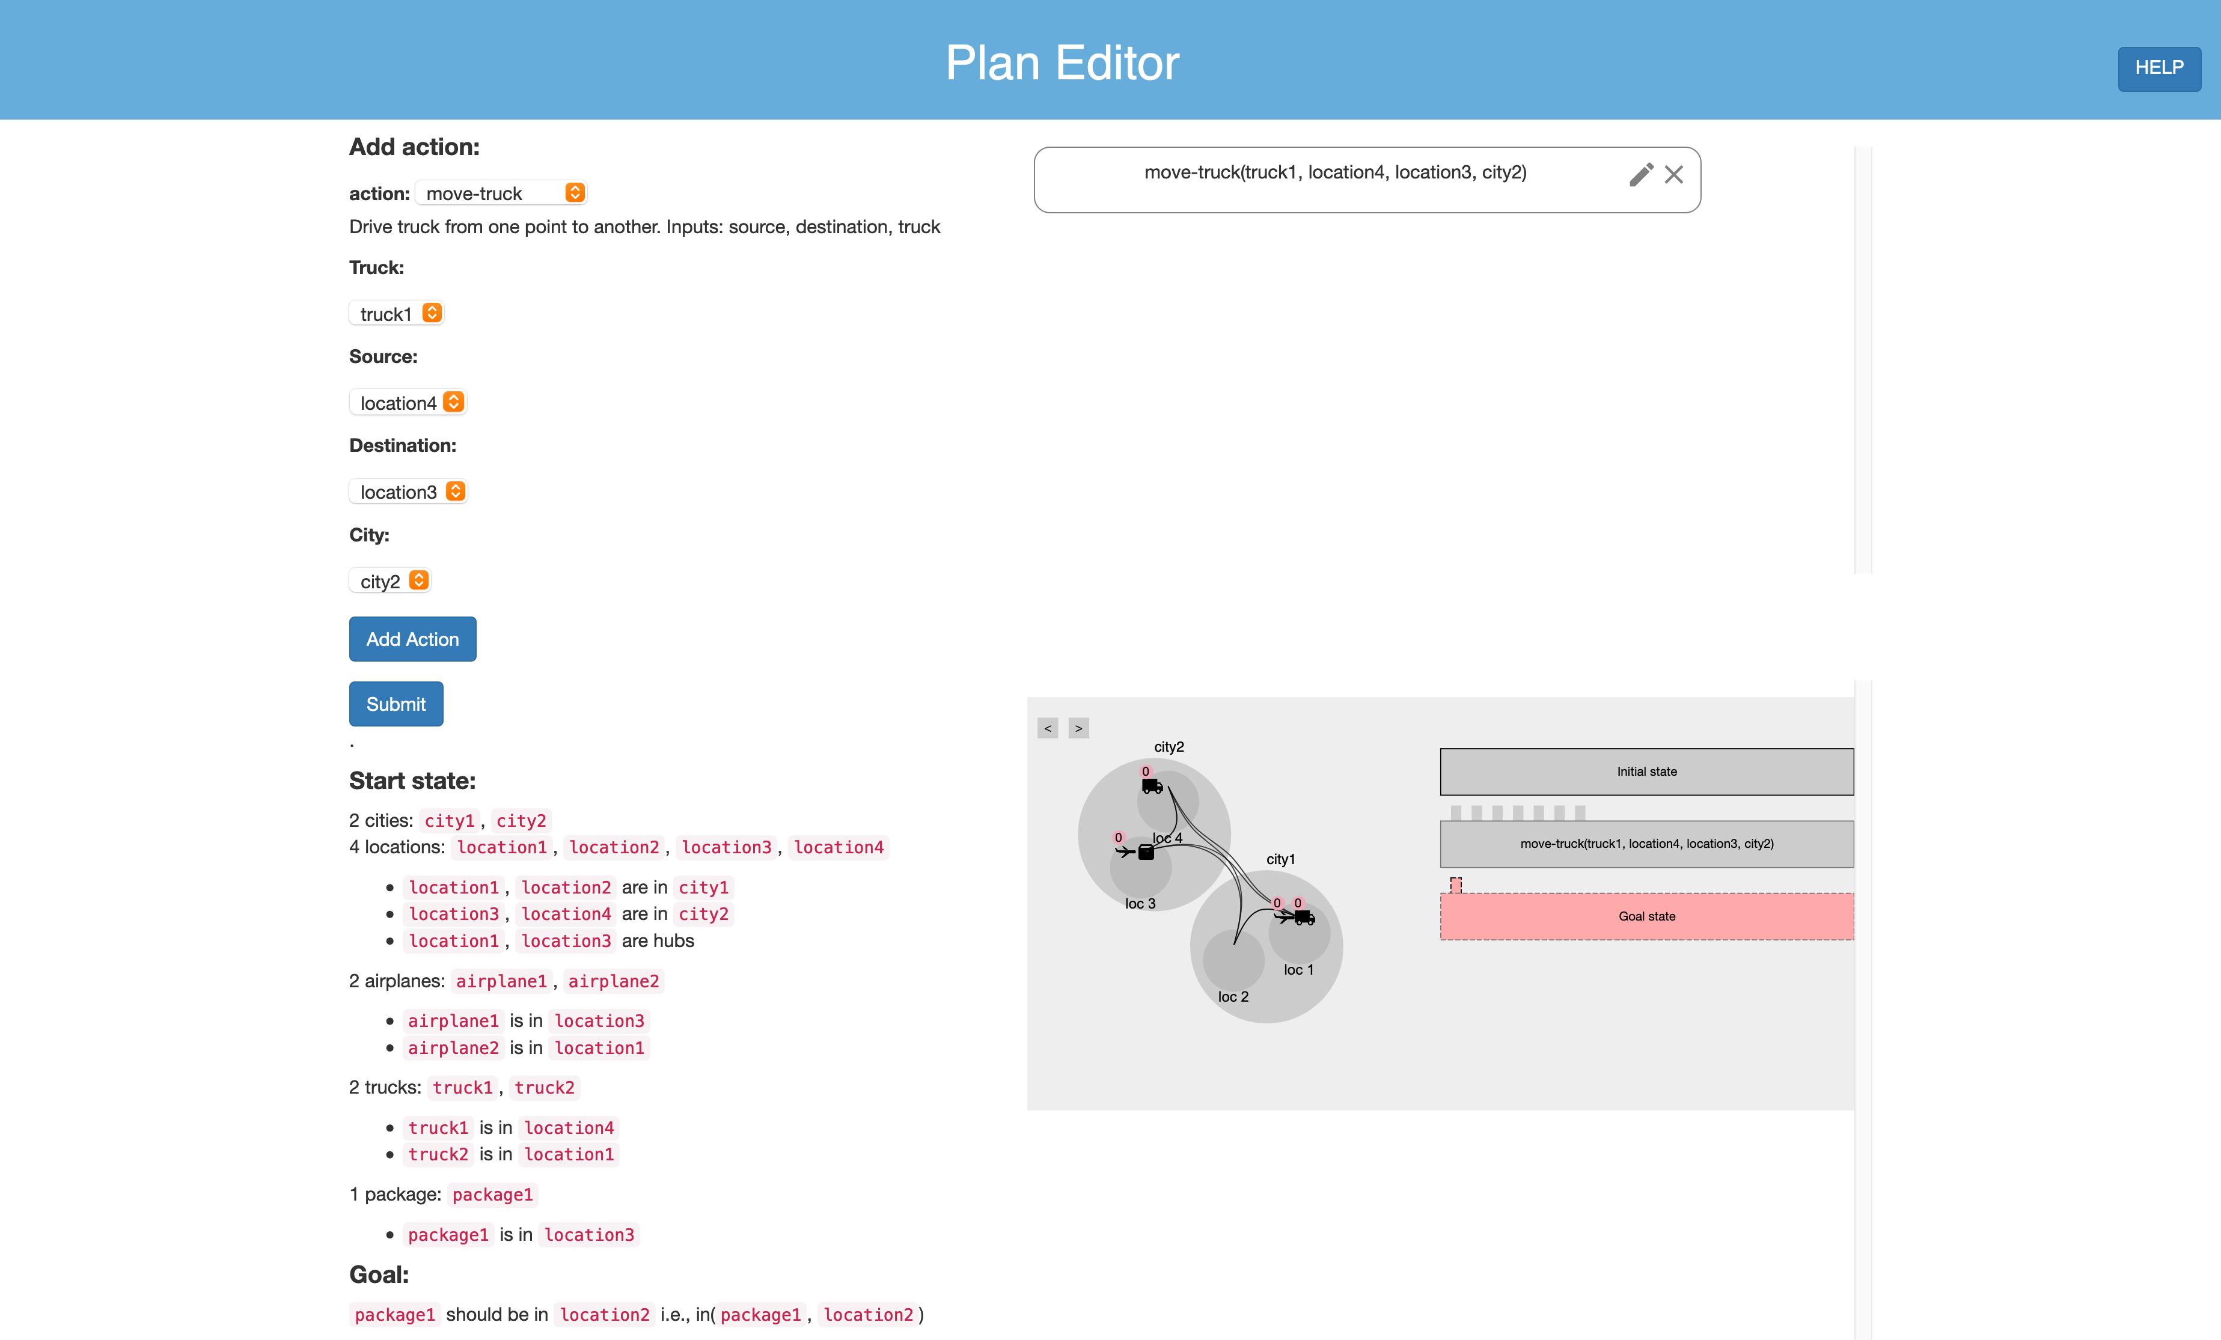

Welcome! This tutorial will guide you through the components of the plan editor.

Slide 2
This area shows the initial and goal states of the planning problem.

Slide 3

In this area you can select the available actions of the problem. Selecting an action brings up the possible parameters to select from.

Slide 4
Clicking this button adds the action to the current plan.

Slide 5
This area will show the plan you are creating. The steps are executed in a top-down fashion. You can either edit the actions or delete them. You can also drag actions to rearrange their order.

Slide 6
This area shows the visualization of your current plan. You can use it to test your plan.
TEST AREA

Slide 7
Clicking this button will submit the plan you have created. Before submitting, ensure that the goal can be achieved, and there are no errors in the plan.

Slide 8
TEST AREA

